Slide 1
Week 3 Basic SQL

Slide 2
SQL Data Definition and Data Types

Slide 3
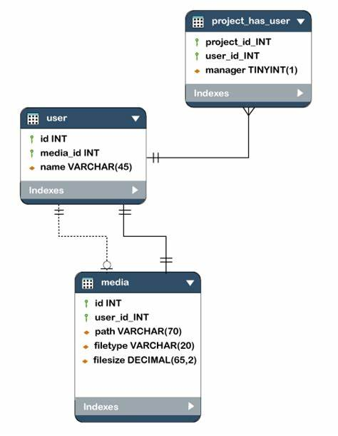
Schemas
A collection of interrelated tables in a database
Authorization identifier – permissions can be set on different users
Ex: Admin (read/write/execute) & query users who may only be able to perform reads
Schemas contain tables, types, constraints, views, domains

Slide 4
Create Statements
Create Schema is used to create a schema in a database
CREATE <schema_name> AUTHORIZATION <user>;
Create table is used to create a table within a schema, column names, types, and constraints are defined within (). These are physically stored on disk
CREATE <schema name>.<table name>
(
<column name> <type> <constraint>,
<column name> <type> <constraint>,
…
);

Slide 5
Data Types
Numeric
INT: Represents 4-byte signed integer numbers. (10 digits)
BIGINT: Represents 8-byte signed integer numbers. (20 digits)
SMALLINT: Represents 2-byte signed integer numbers. (5 digits)
FLOAT: Represents 4-byte single-precision floating point numbers.
DOUBLE: Represents 8-byte single-precision floating point numbers.
DECIMAL(p,s): Represents numbers with maximum precision p and fixed scale s.
For example a DECIMAL(5, 2) has a range of: -999.99 to 999.99.
Character
CHAR(n): Where n denotes the number of characters
VARCHAR(MAX): Where max is the maximum number of characters possible. (up to 2GB in some instances)
CLOB(size): Size denotes the amount of text that can be stored in bytes.
Bit-string
BLOB(size): Size denotes the amount of binary data that can be stored in bytes.
Boolean: True/False data
Date
DATE: yyyy-mm-dd format
TIMESTAMP: yyyy-mm-dd hh:mm:ss
PostgreSQL: Documentation: 15: Chapter 8. Data Types

Slide 6
Specifying Constraints

Slide 7
Attribute Constraints
Basic Types
NOT NULL
Ensures that NULLs are not inserted into the field
DEFAULT
If a NULL value is attempted, a default value will be inserted in its place
CHECK
Can be used to ensure a value being inserted falls within a set of values
Keys and Referential Integrity
PRIMARY KEY – specifies the primary key of the table
UNIQUE – specifies alternate candidate keys
FOREIGN KEY – specifies referential integrity
REFERENCES <table name> <primary key>
Referential trigger action – alternate action if the referential integrity is violate
ON UPDATE/ON DELETE CASCADE/SET NULL/SET DEFAULT

Slide 8
Retrieval Queries

Slide 9
Basics: SELECT, FROM, WHERE
SELECT <columns>
Used to select specific columns in the table
Comma separated names
FROM <schema>.<table>
Indicates the table you are querying against
WHERE <column> <operator> <condition>
The filter on the table
Can have multiple filters using AND/OR
Operators:
SQL Operators: The Complete Guide - Database Star
PostgreSQL: Documentation: 6.3: Operators
SELECT
emps.FNAME
,emps.LNAME
,emps.SSN
FROM emp_db.employees emps
WHERE emps.DOB <= “1990-01-10”
AND emps.LNAME IN (“Smith” ,“Brady”)
;
Alternately:
SELECT * would retrieve ALL columns from the table

Slide 10
Basics: DISTINCT, UNION, LIKE, BETWEEN, ORDER
DISTINCT
Eliminates duplicate values in the SELECT statement
UNION
Combines two sets of data (two table queries)
LIKE
Can be used to match substrings
% is the multicharacter wildcard operator
_ is used to denote a single wildcard
BETWEEN
Used in where statement to select numerical values between a range
ORDER BY
Orders the output by the columns specified with ASC or DESC
SELECT DISTINCT
emp.FNAME
,emp.LNAME
FROM emp_db.employees emp
WHERE
emp.LNAME LIKE “%son”
AND
( emp.SALARY BETWEEN 75000 AND 100000)
ORDER BY emp.LNAME DESC
UNION
SELECT DISTINCT
emp.FNAME
,emp.LNAME
FROM emp_db.employees emp
WHERE
emp.LNAME LIKE “O’%”
AND
( emp.SALARY BETWEEN 75000 AND 100000)
ORDER BY emp.LNAME DESC;

Slide 11
Basics: INSERT, UPDATE, DELETE
INSERT
Used to insert records into a table
You can use queries to insert records
INSERT INTO <schema>.<table>
VALUES (<recorda>,<recordb>,…);
UPDATE
Used to modify the attributes of a table
Where clause is used to identify the rows affected in the update
UPDATE <schema>.<table>
SET <columna>=<value>,<columnb>=<value>,…
WHERE <column><operator><condition>;
DELETE
Used to delete records in a table
Where clause is used to identify the rows affected in the delete
DELETE FROM <schema>.<table>
WHERE <column><operator><condition>;

Slide 12
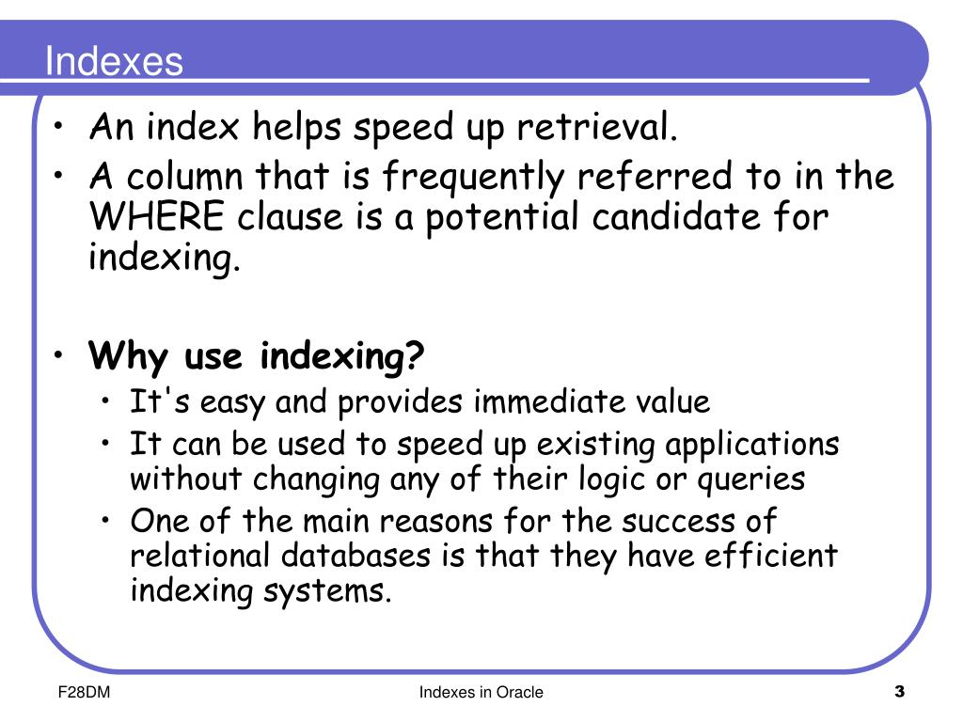
Indexes
CREATE INDEX
CREATE INDEX <index name> ON <schema>.<table> (<index column>);
Read chapter 17 of the book
SQL Server Documentation
UNIQUE
No two rows are permitted to have the same value, think primary key
CLUSTERED
Logical order of the key values determines the order of the rows in the table
NONCLUSTERED
The physical order of the data rows is independent of their indexed order.

